Slide 1
Rideshare Application
External
Internal
Rideshare Database
Optimizer
Rideshare Control
Internet
User Interface
Secure Session Manager
Google Geocoder
Google Maps
Users
Internet

Slide 2
Optimizer
Rideshare Requests
Problem Reduction
Ride Offers
Ride Requests
User Criteria
Geographic Criteria
Possible Rideshare Matchings
Matching Algorithm
Bipartite Graph Matching
Other Maximal Matching Algorithms
Set 1
D
R
Match Evaluator
Set N
Google Maps
Control
Optimized
Results
D
R

Slide 3
Rideshare Control
Rideshare Database
User Interface Control
Optimizer Control
User Interface
Server Control
Database Control
Optimizer
Arbiter
Backup

Slide 4
User Interface
Secure Session Manager
Input
Output
Form
Form
Google Maps
Menu
Menu
Interactive Map
Interactive Map
Google Geocoder
Page Frame
Statistical/History Utility
User Profile Data
Rideshare Requests
Rideshare
Control
Optimized
Results
User History Data
Ride Offers
Ride Requests
Site Statistical Data

Slide 5
Secure Session Manager
User Interface
User Authentication
Session Manager
Browser
Communication Manager
Email
Secure Sessions
Data
User Profile Information

Slide 6
Rideshare Database
Possible Rideshare Matchings
User Profile Data
Optimized
Results
User History Data
Set 1
D
R
Site Statistical Data
Rideshare Requests
Ride Offers
Secure Sessions
Data
Set N
Ride Requests
D
R
User Interface
Optimizer
Secure Session Manager

Slide 7
Login Page
Rideshare
Welcome to Rideshare
Please log in to your account:
Email Address
Password
What is Rideshare?
Don’t have an account?
Click here to register.

Slide 8
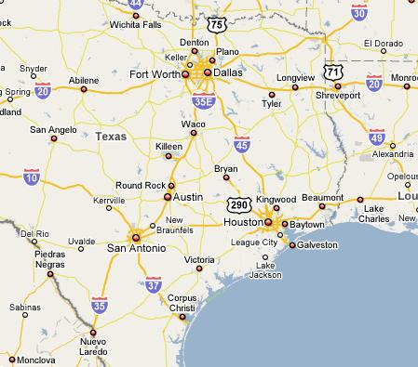
Ride Request Page
New
Ride Request
Origin/destination
origin
destination
Time window
latest departure
latest arrival
Confirm
Advanced Options

Slide 9
Ride Request Page - Rider
New
Ride Request
Riding
Driving
Origin/destination
origin
destination
Time window
date
earliest departure
latest arrival
Confirm
Advanced Options

Slide 10
Ride Request Page - Rider
My Rides
My Profile
New Ride
My Friends
Main Page
New Ride
Riding
Driving
Origin/destination
origin
destination
Time window
date
earliest departure
latest arrival
Confirm
Advanced Options
Gender preference
Age preference
Driver Options
Rating
Maximum Passengers

Slide 11
New Route
My Rides
My Profile
New Ride
My Friends
Main Page
New Route
Route Details
Time Window*
Start Location
End Location
(Check One)
I need a ride
I am driving
Confirm
Advanced Options
Notes:
Is time window arriving or leaving?? Do we need a separate new route page for both

Slide 12
New Route (Advanced Options)
My Rides
My Profile
New Ride
My Friends
Main Page
New Route
Route Details
Time Window*
Start Location
End Location
(Check One)
I need a ride
I am driving
Confirm
Advanced Options
Notes:
Is time window arriving or leaving?? Do we need a separate new route page for both

Slide 13
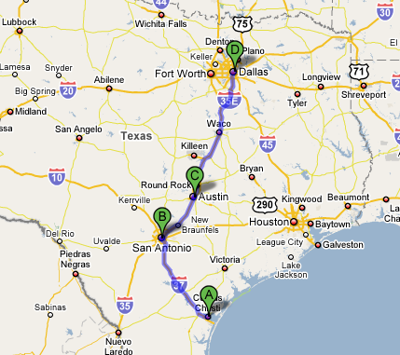
Confirmation Request Page
Confirm Passenger
Passenger Details
Name, Rating
Pickup Location/Time
Drop off Location/Time
My Route Details
Start Location/Time
End Location/Time
Confirm
Reject

